Slide 1
Making Mobile Apps Simple with F#
EXF - Elmish + Xamarin
Don Syme, Researcher, F# Community Contributor
Jim Bennett, Cloud Dev Advocate
+ contributors

Slide 2
fsprojects.github.io/Elmish.XamarinForms

Slide 3
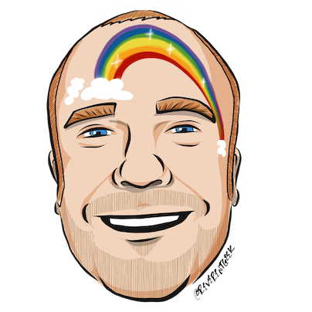






thanks
Timothé Larivière
co-maintainer on EXF, author of ElmishContacts and ElmishPlanets demos
Jim Bennett
will talk a bit about using EXF and give a demo
Boris D. (github @dboris)
authored “Elmish.Forms” (“half-elmish” for static views only)
Jason Imison
F# in Visual Studio for Mac and Xamarin
Eugene Tolmachev
Creator or “Elmish” for Fable, used for WPF and others
Justin Sacks and others
Creators of “Elmish.WPF” (“half-elmish” for static views only)
Alfonso, Maxime, Steffen and many others
The Fable gang

Slide 4
CaveatS
New talk, first time
I’m not a UI designer, I’m a compiler/framework guy
Today the basics of EXF.: good design and app dev is up to you
EXF is open source, community-based, can evolve
Not a Microsoft product
EXF is used with things like Xamarin.Essentials
Please contribute and share
fsprojects.github.io/Elmish.XamarinForms
FSSF Slack “mobiledev”
Twitter #fsharp

Slide 5
GUIDE
The journey
The problem
The hope
The basics
Demos
Making it efficient
Unit testing
Extensibility
Live update

Slide 6
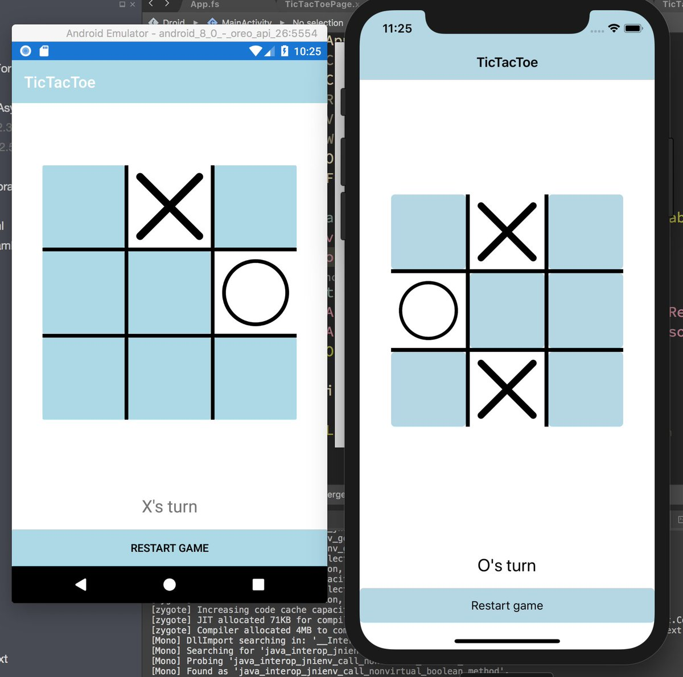
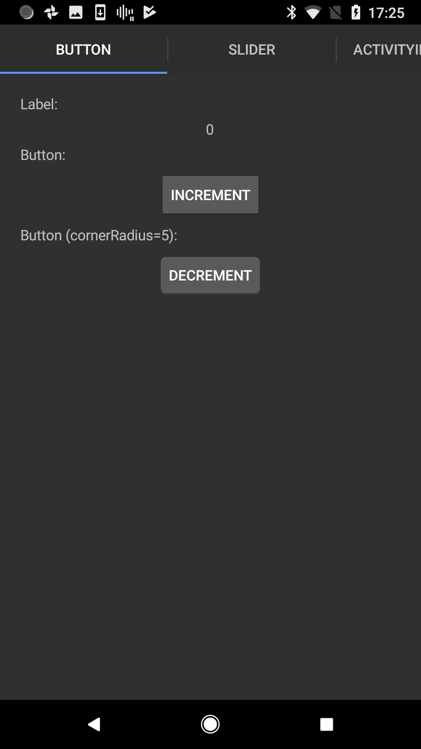
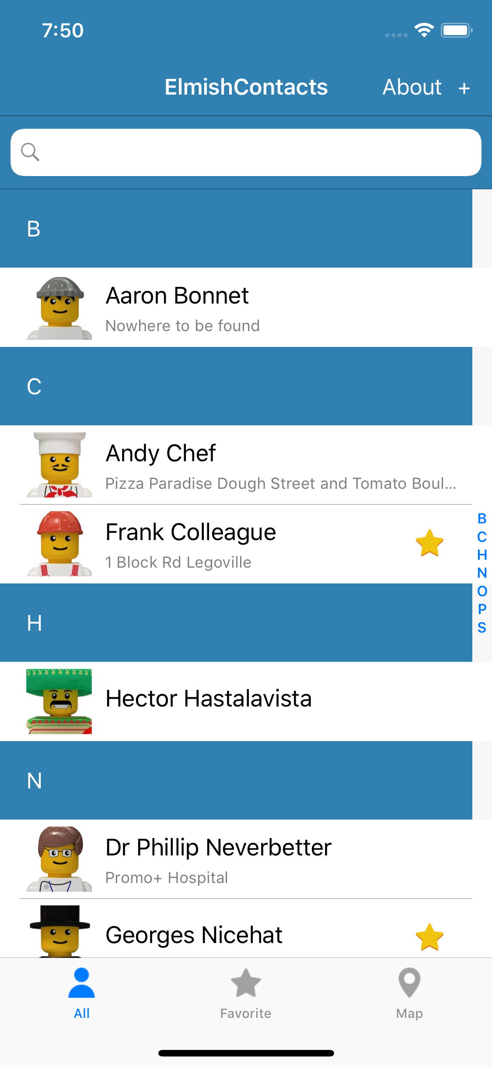
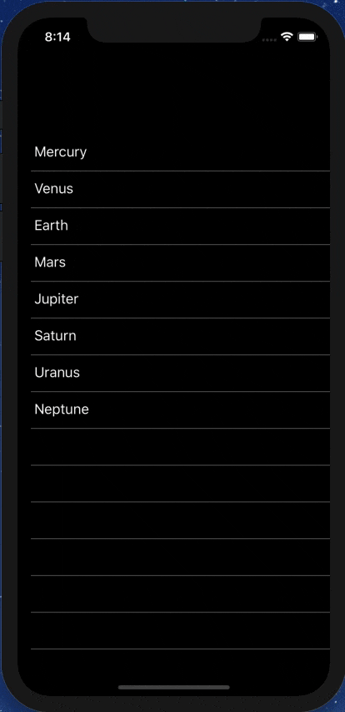
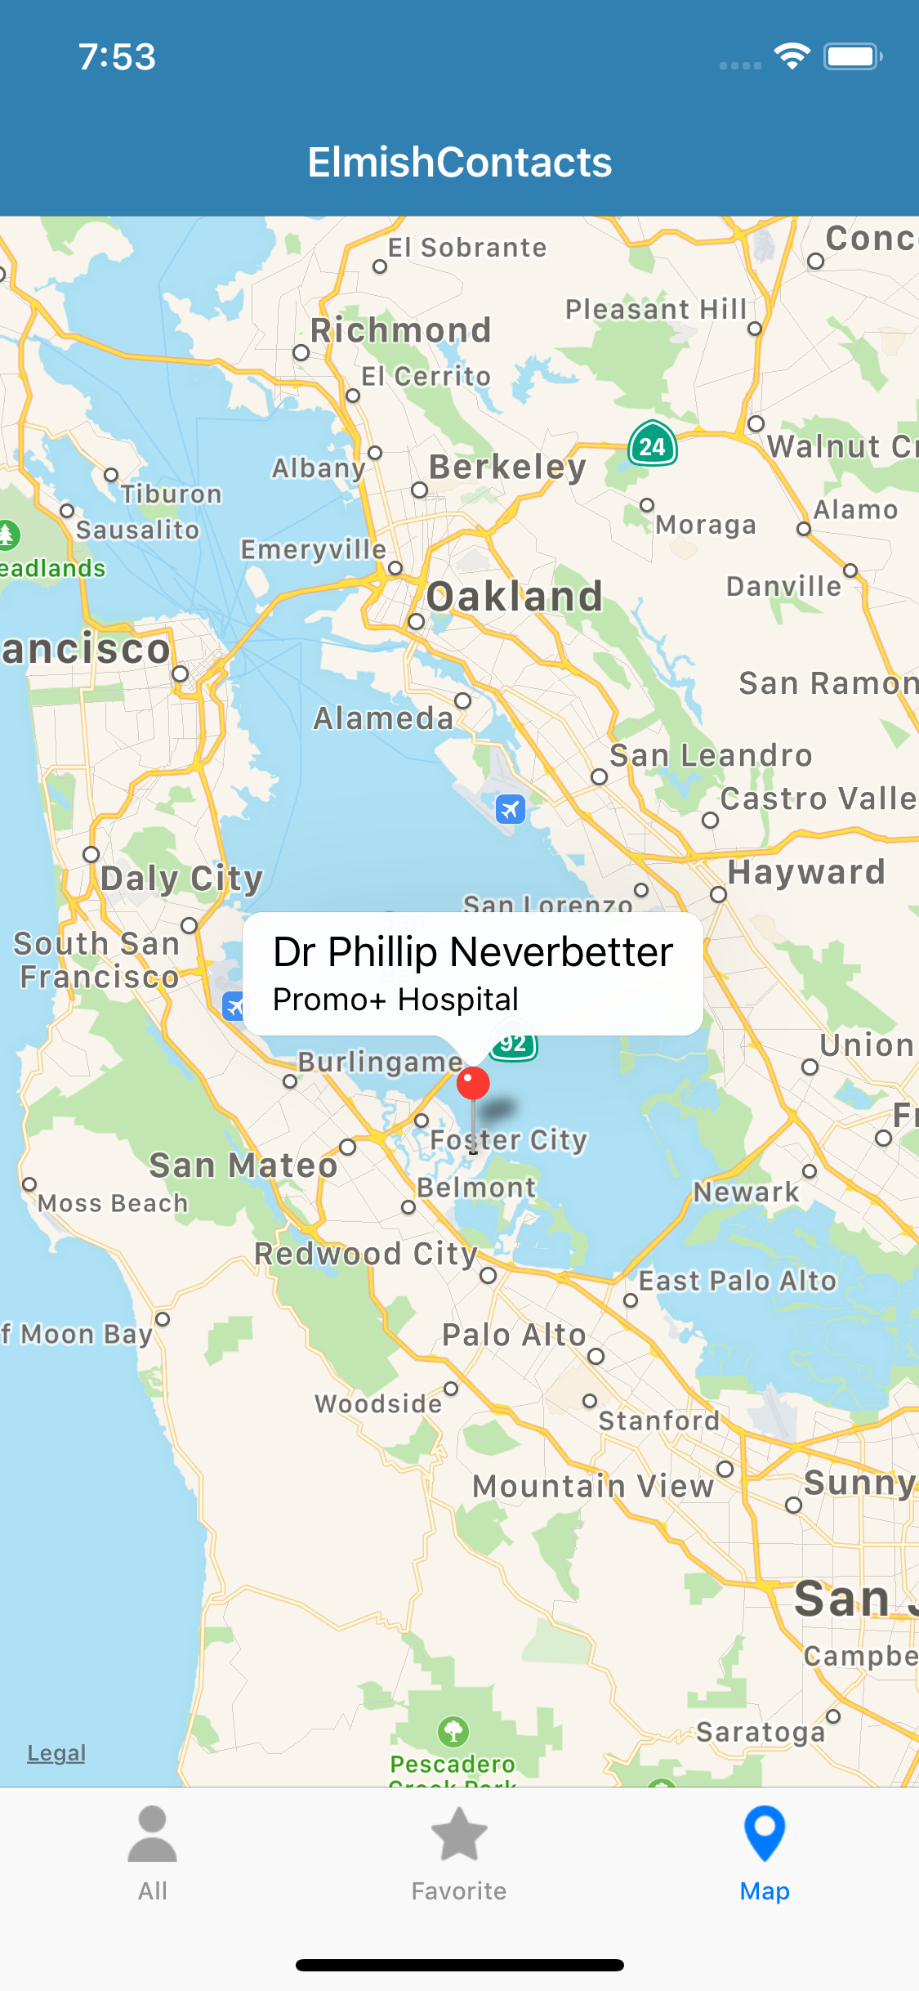



Slide 7
The journey
Early F# embraced functional programming but lacked opinion on functional app development
I’m doing 2 years with the Xamarin/DevDiv teams. 50% F# and 50% other things.
We live on an Android/iOS planet (+web +windows). F# developers need to be able to go mobile.
Xamarin is a mature .NET-to-mobile toolchain with very solid components and excellent .NET affinity (.NET Standard 2.0, full .NET semantics, Xamarin.Forms for xplat mobile)
My question in Jan-Jul 2018: Can we make Xamarin simple and compelling for F# app development?
Notes:
Some good options existed but hadn’t quite taken hold. “winforms designer! WPF designer! Xaml designer on Mac! webforms designer! Xcode designer! Class designer! class browser!”. Some semi-functional architectures too (WebSharper UI.Next, Gjallahorn, others). ReactNative and other options are perceived as being functional-friendly. Can we make Xamarin friendly for F# developers?

Slide 8
THE PROBLEM WITH XAML
Existing F# UI development follows three architectures
Adhoc. WinForms plus callbacks.
MVVM #1. State in mix of UI controls and mutable model and view model. View is static Xaml.
MVVM #2: Mutable reactive (Gjallahorn, WebSharper UI.Next, Half Elmish). State held in mutable model elements and modification triggers updates to a mutable UI.
A core problem: MVVM+Xaml is not simple
Xaml was designed on the premise that “designers” would need the UI sliced off from code into a separate DSL.
Xaml is static, with layers of complexity (e.g. templating), and code-like constructs (behaviours, convertors), and requires complex designer tooling (which often fails).
Separating the UI is fine, but do we really need a separate language to do it?
That said, lots of people do F# + MVVM + Xaml with WPF and/or Xamarin.

Slide 9
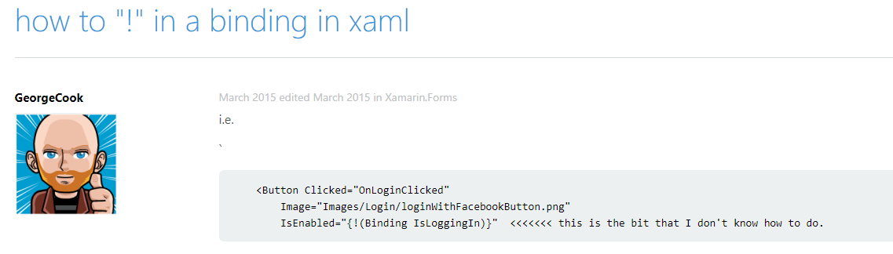
THE PROBLEM WITH XAML

Slide 10
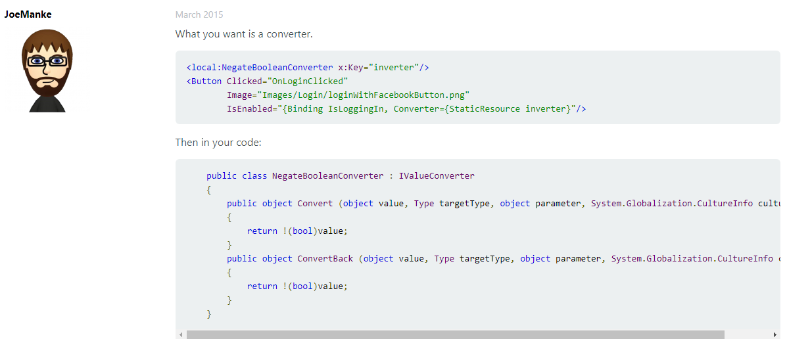
THE PROBLEM WITH XAML

Slide 11
INSPIRATION
Fable has popularized the “Elm” architecture in F#
Fable+Elmish makes web app development simple
All F# code
View descriptions are separated but simple, and in F#
I’m very influenced by SAFE Stack
Steffen Forkmann reports that non-F# people have found Fable+Elmish simple and easy in business contexts (client/cloud e-charging stations)
http://fable.io http://github.com/elmish
https://safe-stack.github.io/

Slide 12
THE NEED
What’s needed?
the simplicity of Fable + Elmish, but for Xamarin
(aside: you can do Fable+Elmish to ReactNative already)

Slide 13
A SIMPLE EXF APP
/// The model from which the view is generated
type Model =
{ Pressed: bool }
/// The messages which cause updates to the model
type Msg =
| Pressed
/// Returns the initial state
let init() =
{ Pressed=false }
/// The function to update themodel
let update (msg: Msg) (model: Model) =
match msg with
| Pressed -> { model with Pressed = true }
/// The function to produce the view elements for a given model
let view (model: Model) dispatch =
if model.Pressed then
View.Label(text="I was pressed!")
else
View.Button(text="Press Me!", command=(fun () -> dispatch Pressed))
type App () as app =
inherit Application ()
let runner =
Program.mkProgram App.init App.update App.view
|> Program.runWithDynamicView app

Slide 14
Getting started
Install Visual Studio
(Mac or Windows with .NET Core and Xamarin enabled)
Create an app
Plug in your Android via USB, enable developer mode, install USB drivers (Windows) etc.
Build/deploy
dotnet new -i Elmish.XamarinForms.Templates
dotnet new elmish-forms-app -lang F# -n FriedChickenApp
msbuild FriedChickenApp\FriedChickenApp.sln

Slide 15
Demo 1

Slide 16
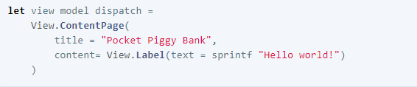
The VIEW DSL
Views are expressed using a DSL
It’s like Xaml, only in F# code.
Lots of named, optional arguments, a fundamental tool for attribute-heavy DSLs in F#.

Slide 17
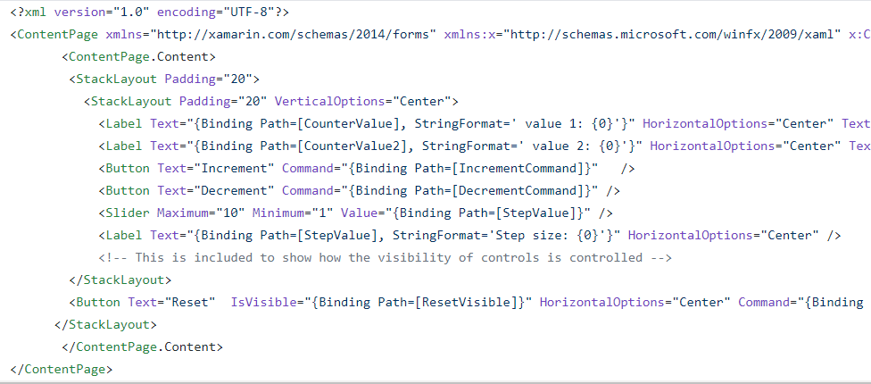
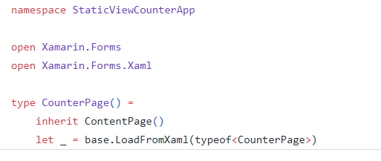
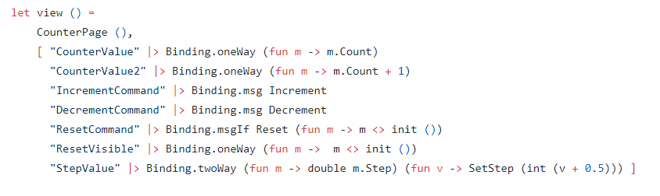
The VIEW DSL
Views are expressed using a DSL
It’s like Xaml, only in F# code and simple

Slide 18
The VIEW DSL
Views are expressed using a DSL
It’s like Xaml, only in F# code and simple
let view (model: Model) dispatch =
View.ContentPage(content=
View.StackLayout(padding=30.0,verticalOptions = LayoutOptions.Center, children=[
View.Label(text= string model.Count, horizontalOptions=LayoutOptions.Center)
View.Button(text="Increment", command= (fun () -> dispatch Increment))
View.Button(text="Decrement", command= (fun () -> dispatch Decrement))
View.Slider(minimum=0.0, maximum=10.0, value=model.Step,
valueChanged= (fun args -> dispatch (SetStep (int args.NewValue))))
View.Label(text=sprintf "Step size: %d" model.Step, horizontalOptions=LayoutOptions.Center)
View.Button(text="Reset", horizontalOptions=LayoutOptions.Center,
command=(fun () -> dispatch Reset), canExecute = (model <> initModel () ))
]))

Slide 19
The VIEW DSL
The view function returns a ViewElement
Simple correspondence to Xamarin.Forms elements
A ViewElement is a property bag (immutable array of properties)
“Data binding” replaced by “view evaluation”
You don’t _react_ to data change, you simply re-evaluate the view
More on performance later
Multi-page apps have a single view function that returns multiple pages (e.g. a navigation stack)

Slide 20
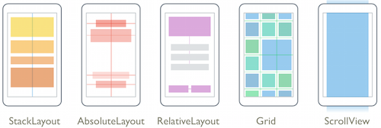
The VIEW DSL
Layouts

Slide 21
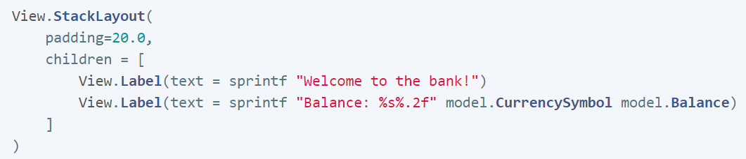
The VIEW DSL
Layouts

Slide 22
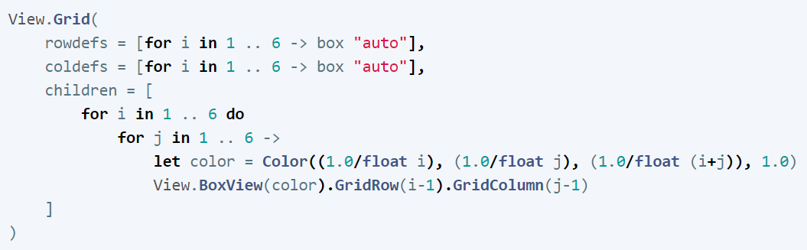
The VIEW DSL
Layouts

Slide 23
How TO THINK: Models and messages
“The model is what gets saved when an app sleeps.”
It must be “enough” to resurrect the essential state of the app on resume. This must be fully explicit.
“Given a model you can compute the view”
using pure functional code
“Given a message you can compute the next model”
using pure functional code + possibly triggering future messages

Slide 24
Dynamic VIEWS
UI is often dynamic.
A game grid changes size
View elements come and go
Content changes
App modes change (logged in/logged out)
One joy of Elmish is that dynamic UIs are very simple to prototype

Slide 25
The VIEW DSL
That original example
let view (model: Model) dispatch =
View.ContentPage(content=
View.StackLayout(padding=30.0,verticalOptions = LayoutOptions.Center, children=[
View.Label(text= string model.Count, horizontalOptions=LayoutOptions.Center)
View.Button(text="Increment", command= (fun () -> dispatch Increment))
View.Button(text="Decrement", command= (fun () -> dispatch Decrement))
View.Slider(minimum=0.0, maximum=10.0, value=model.Step,
valueChanged= (fun args -> dispatch (SetStep (int args.NewValue))))
View.Label(text=sprintf "Step size: %d" model.Step, horizontalOptions=LayoutOptions.Center)
View.Button(text="Reset", horizontalOptions=LayoutOptions.Center,
command=(fun () -> dispatch Reset), canExecute = model.Changed)
]))

Slide 26
The VIEW DSL
That original example
let view (model: Model) dispatch =
View.ContentPage(content=
View.StackLayout(padding=30.0,verticalOptions = LayoutOptions.Center, children=[
View.Label(text= string model.Count, horizontalOptions=LayoutOptions.Center)
View.Button(text="Increment", command= (fun () -> dispatch Increment))
View.Button(text="Decrement", command= (fun () -> dispatch Decrement))
View.Slider(minimum=0.0, maximum=10.0, value=model.Step,
valueChanged= (fun args -> dispatch (SetStep (int args.NewValue))))
View.Label(text=sprintf "Step size: %d" model.Step, horizontalOptions=LayoutOptions.Center)
View.Button(text="Reset", horizontalOptions=LayoutOptions.Center,
command=(fun () -> dispatch Reset), canExecute = not model.Unchanged)
]))
How easy is that?

Slide 27
Demo II
Jim Bennett

Slide 28
UNIT TESTING
Elmish is a joy to unit test
Pass in a mock “dispatch” function to test “view”
Can test each message using mock models

Slide 29
MAKING IT EFFICIENT
Re-evaluating the view on each update sounds odd
Surprisingly, it is ok when updates are human-speed
Returning “equal” view elements causes zero update for that subtree
Use “dependsOn” to prevent view re-evaluation
New views are applied differentially to actual visual objects
Step by step diff of previous and next view
No updates if base properties don’t change
Lists updated incrementally for changes at end
You’re in control
can write custom differential update for custom view elements

Slide 30
Making it efficient
let view model dispatch =
…
View.Slider(minimum=0.0, maximum=10.0,
value=double model.Count,
valueChanged=(fun args -> dispatch (SliderValueChanged args.NewValue)))
…

Slide 31
Making it efficient
let view model dispatch =
…
dependsOn (…) (fun model (count, step) ->
…
)
…

Slide 32
Making it efficient
let view model dispatch =
…
dependsOn (model.Count, model.Step) (fun model (count, step) ->
View.Slider(minimum=0.0, maximum=10.0,
value=double count,
valueChanged=(fun args -> dispatch (SliderValueChanged args.NewValue))))
…

Slide 33
MAKING IT EFFICIENT
Aim is to change perf of “view” function to be near-constant time
Other techniques:
ConditionalWeakTable: associate sub-model elements → view elements
Keep version counters in model to assist dependsOn
Large lists (> ~1000) are a separate topic, see documentation

Slide 34
Demo III

Slide 35
LEARN!
ElmishContacts is a great example
On-device per-app SQL-Lite integration
Using maps
Asynchronous data loading onto maps
Catching exceptions and being robust
Sending SMS, making phone calls and Email using Xamarin.Essentials
Multi-page with external messages reconciled via the composed app
Editing and searching lists of things
Taking photos
Splash screens
Decent design

Slide 36
Multi-page apps
A multi-page app still has a single view function
e.g. CarouselPage, TabbedPage with child pages
Navigation pages has a stack of sub-pages
A multi-page app also has a single model, single message type and single update function
Pages (or sub-views) can be developed independently
You compose from pieces, either with combinators or manually

Slide 37
How to think: composition
“The pieces compose separately”
Compose the models, messages, update functions, view functions separately
“External” messages must be resolved during composition
“Encapsulation is not the emphasis”
The sub-page models not hidden when composed
OO encapsulation is strongly de-emphasized for model/view/update

Slide 38
EXTENSIBILITY
You can define your own view extensions easily
Available extensions
Maps (native maps, fully open source)
SkiaSharp (2D graphics and animations , fully open source)
OxyPlot (really great charting, fully open source)
Urho (3D graphics, fully open source)
Each in its own small DLL
Please contribute your own!

Slide 39
Demo IV

Slide 40
Extensibility (VIEW ELEMENTS)
let makeScrollingContentPage(title, children) =
View.ContentPage(title=title,
content=View.ScrollView(View.StackLayout(padding=20.0, children=children) ),
useSafeArea=true)
let makeNonScrollingContentPage(title, children) =
View.ContentPage(title=title,
content=View.StackLayout(padding=20.0, children=children),
useSafeArea=true)
… then …
makeScrollingContentPage("MyPage", [ … ])
makeNonScrollingContentPage("MyPage", [ … ])

Slide 41
Extensibility (VIEW ELEMENTS)
type View with
static member ScrollingContentPage(title, children) =
View.ContentPage(title=title,
content=View.ScrollView(View.StackLayout(padding=20.0, children=children) ),
useSafeArea=true)
static member NonScrollingContentPage(title, children) =
View.ContentPage(title=title,
content=View.StackLayout(padding=20.0, children=children),
useSafeArea=true)
… then …
View.ScrollingContentPage("MyPage", [ … ])
View.NonScrollingContentPage("MyPage", [ … ])

Slide 42
Extensibility (VIEW ELEMENTS)
type View with
static member Map( … optional arguments … ) =
…need an entirely new kind of ViewElement…

Slide 43
Extensibility (VIEW ELEMENTS)
type View with
static member Map( … optional arguments … ) =
// Count the number of additional attributes
let attribCount = …
// Populate and count the inherited attributes
let attribs = View.BuildView(attribCount)
// Add our own attributes
…
// The incremental update method
let update prevOpt source target =
…
// Put the pieces together
ViewElement.Create(…, update, attribs)

Slide 44
extensibility
type View with
static member inline Map(?pins: seq<ViewElement>, ?requestedRegion: MapSpan) =
// Count the number of additional attributes
let attribCount = 0
let attribCount = match pins with Some _ -> attribCount + 1 | None -> attribCount
let attribCount = match requestedRegion with Some _ -> attribCount + 1 | None -> attribCount
// Populate the inherited attributes
let attribs = View.BuildView(attribCount)
// Add our own attributes
match pins with None -> () | Some v -> attribs.Add(MapPinsKey, v)
match requestedRegion with None -> () | Some v -> attribs.Add(MapRegionKey, v)
// The update method
let update (prevOpt: ViewElement voption) (source: ViewElement) (target: Map) =
source.UpdateElementCollection(prevOpt, MapPinsKey, target.Pins)
source.UpdatePrimitive(prevOpt, target, MapRegionKey, (fun target span -> target.MoveToRegion span))
// The element
ViewElement.Create(Xamarin.Forms.Maps.Map, update, attribs)
Funky use of F# inline means each particular Map gets pre-counted attributes and minimal update code

Slide 45
Live update
An experimental LiveUpdate mechanism is available
F# code for the core of your app is recompiled on host and interpreted on device
Communication to device via adb/http
Update times ~2sec
Current limitations (please help!)
One file only
No state-migration as yet
Some manual start-up steps
DEBUG mode only
Some bugs/limitations in on-device interpreter
Some differences in semantics for on-device interpreter (e.g. typeof)

Slide 46
CHEATING
Some cheats are available
View.Stateful:
adds local mutable state unrelated to the model. Breaks the functional approach but has uses for ephemeral state and rapid-mutation code.
View.WithInternalModel:
similar but for local immutable state
View.External:
wraps external Xamarin Forms objects, e.g. Page or View.

Slide 47
Pragmatics
State persistence
Prototyping simple, just serialize XML
Time-travel debugging
Not enabled by default but easy to add as an in-app feature, app.SetModel(model)
App size
See notes in documentation. Standard Xamarin linking/reduction can be applied
Platform-specifics
Your core app is .NET Standard 2.0
Each platform has a project (App.Droid, App.iOS) and initialization
You can pass in platform helpers
Or use platform conditionals
Deploying
App store deployment and signing follows usual Xamarin processes, linked in docs

Slide 48
SUMMARY
EXF
=
Simple F#-friendly Functional Mobile App Programming
Please get Involved!

Slide 49
Resources
fsprojects.github.io/Elmish.XamarinForms
View snippets
Docs
Links to Samples
Templates
How to use LiveUpdate (for small apps)
The AllControls sample
Awesome-Elmish.XamarinForms!
Xamarin.Essentials
Lots of core services
Xamarin docs (e.g.Forms, Android, iOS setup and deploy)

Slide 50
Thanks!

Slide 51

F#
DO MVVM-XAML FOR MOBILE
(unless it’s expedient, if there are better choices etc. etc.)

